Slide 1
April 2019
Fisher House Foundation Update
for FOFH Community Groups in the Capital Campaign Phase
Brian Gawne
VP for Community Relations (240) 599-2462 bgawne@fisherhouse.org
Notes:
Presentation given to groups in the Capital Campaign phase for a new (or additional) Fisher House at their local medical center

Slide 2
FH Construction Update
Future Construction
Bay Pines, FL (2nd)
Birmingham, AL
Columbia, MO
Columbia, SC
Detroit, MI
Huntington, WV
Kansas City, MO*
Lexington, KY
Montrose, NY
North Chicago, IL
Perry Point, MD
Pittsburgh, PA (2nd)
Shreveport, LA
Ramstein, Germany
San Antonio, TX (2nd)
San Juan, PR
White River Junction, VT
Site Visit Complete
Bay Pines, FL Pines, FL (2nd)
Birmingham, AL
Columbia, MO
Columbia, SCumbi, SC
Detroit, MI
Huntington, WV
Kansas City, MO*
Lexington, KY
Montrose, NY
North Chicago, IL
Perry Point, MD
Pittsburgh, PA (2nd)
Shreveport, LA
Ramstein, Germany
San Antonio, TX (2nd)
San Juan, PR
White River Junction, VT
In Construction
Cleveland, OH (I & II)
Bronx, NY (I & II)
Richmond, VA
Albuquerque
Togus, ME
2019 Remaining Starts
Denver, CO
Ann Arbor, MI
New Orleans, LA
Omaha, NE
2020 Tentative Starts
TBD
(Gold Font = Location with a supporting FOFH Group)
Notes:
Yellow = FOFH Group, i.e. 7 of 9 houses in construction or scheduled to start between now the end of the year have FOFH Groups
Cleveland – actually turned over # 83 and 84, Bronx scheduled May 85, 86, Richmond, Albuquerque, & Togus in a horse race.
Denver GB scheduled in two weeks, Ann Arbor in June – same week as the Cleveland dedication.
17 locations saying…yeah, but what about me???
We’ve completed site visits to 7 of 17 of those locations …Columbia Missouri will likely be one of our next… You do the math.
Bay Pines and San Antonio are the wild cards – existing houses that are full (i.e. demonstrated need – and currently burning through Hotels for Heroes resources)

Slide 3
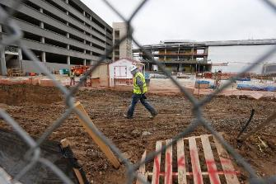
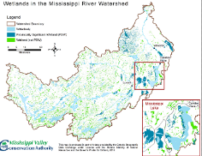
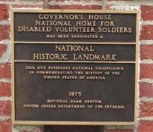
Timing Coordinated With VA
Factors affecting start date selection
Availability of suitable site
State Historic Preservation Process
Environmental Impact Study
Other VA projects on campus
Existing structures
Weather/Climate
Financial Support
Notes:
Need at least 1 acre of suitable land
Section 106 is the portion of the National Historic Preservation Act (NHPA) that is concerned with Federal undertakings. Local SHPO is key player for this process.
Key question – has the medical center recently done an EPA study on the site or are we starting from scratch
Is access to the site contingent on timely completion of other projects on the medical center campus?
Are their existing structures that need to be moved or demolished?
Want to start houses in northern/colder climates in spring to have walls up and framed before first snow in fall. Hurricane season often impacts building in the South,
Firm commitment (cash in hand) from the local community can accelerate a houses priority to start construction

Slide 4
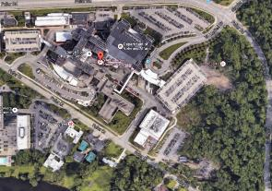
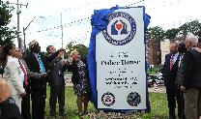
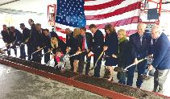
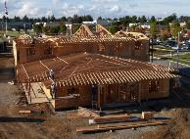
Key Steps for VA, FHF and Community Groups
VA Ventral Office (VACO) and FHF Site Visit to VA Medical Center
VA Site-Prep of Land
Proffer Submission from FHF to VA
Includes VA-approved standard FH basis of design
Proffer Acceptance by Secretary of VA
VA issues permits and revocable license to FHF to begin construction
Completion of Site Prep by VAMC
Ground Breaking Ceremony
FH General Contractor Mobilization

Slide 5
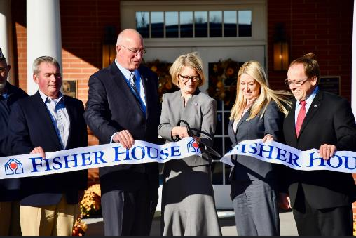
Key Steps for VA, FHF and Community Groups (cont)
Completion of FH Construction
Notification to VA Secretary
VA acceptance of FH
VA staffing and outfitting of FH
Hire Manager & Staff
Install VA-unique systems connected to FH
Locks, security monitors, cable, etc.
Dedication Ceremony
VAMC opens FH and begins accepting FH families

Slide 6
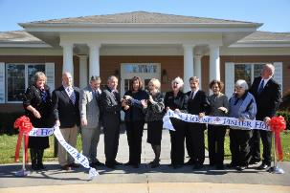
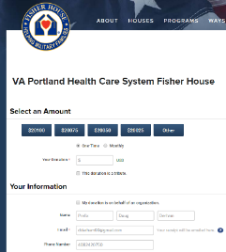
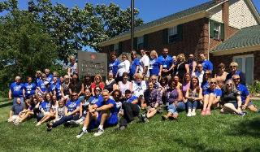
FHF Support – Post Construction
Dedication Ceremony (assist w/ planning & execution)
FHF one-year warranty
Pay DoD lodging fees (not applicable for VA)
Forward designated donations
Gifts-in-kind
Host FH Managers Conference
Host Friends of FH Community Group Conference
Support as required
Notes:
After construction the house is owned by the government but Fisher House still maintains a presence… after hosting a tremendous dedication ceremony!
Fisher House comes with a one-year warranty (common residential new-home warranty); you break it, we fix it…
By regulation, the Department of Defense (DoD) charges families $10 per night. The Foundation pays the lodging fees. (VA does not charge)
We allow donors to designate certain houses for their gifts.
We host an annual managers conference for professional training purposes, as well as an annual conference for the FOFH community groups.
Whatever is necessary to keep the houses to standard.

Slide 7
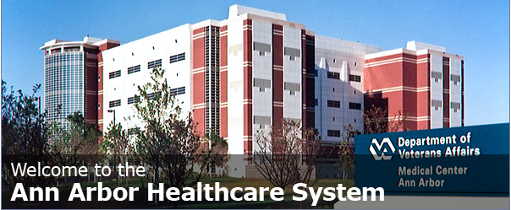
FHF transfers FH ownership to VAMC
Key VA Medical Center Responsibilities:
Establish the Facility Fisher House Program
Identify Fisher House Program Alignment within the organization
Establish a Fisher House Steering Committee
Hire a Fisher House Manager and plan for support staff
Educate VA staff and the community about Fisher House
VA Community Engagement and Media
Fisher House Web Course availability for all VA staff
Maintain other VA temporary lodging or Hoptel Program
Develop a local Fisher House Policy and Computerized Patient Record System (CPRS) consult for referrals
Notes:
Taken from VA’s slides provided by the VA FH Program Manager, Jennifer Koget

Slide 8
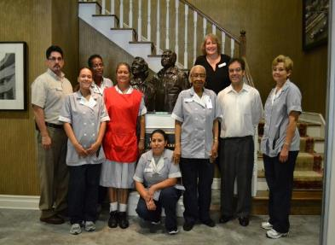
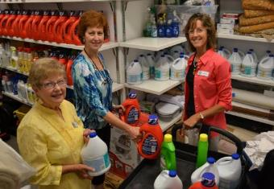
VA Owns & Operates the FH
VA staffs the Fisher House
Local FH Manager,
Asst Manager /Program Asst
Housekeepers
VAMC funds day-to-day operation costs, including:
Utilities,
General upkeep
Annual Fisher House Refurbishment (funded through VISN) VA is committed to maintaining Fisher Houses in pristine condition
VA Coordinates Volunteers
Through VAMC Voluntary Services Office
VA coordinates support from FHF & local community groups, and other supporters
VA Informs the public of this new asset

